Slide 1
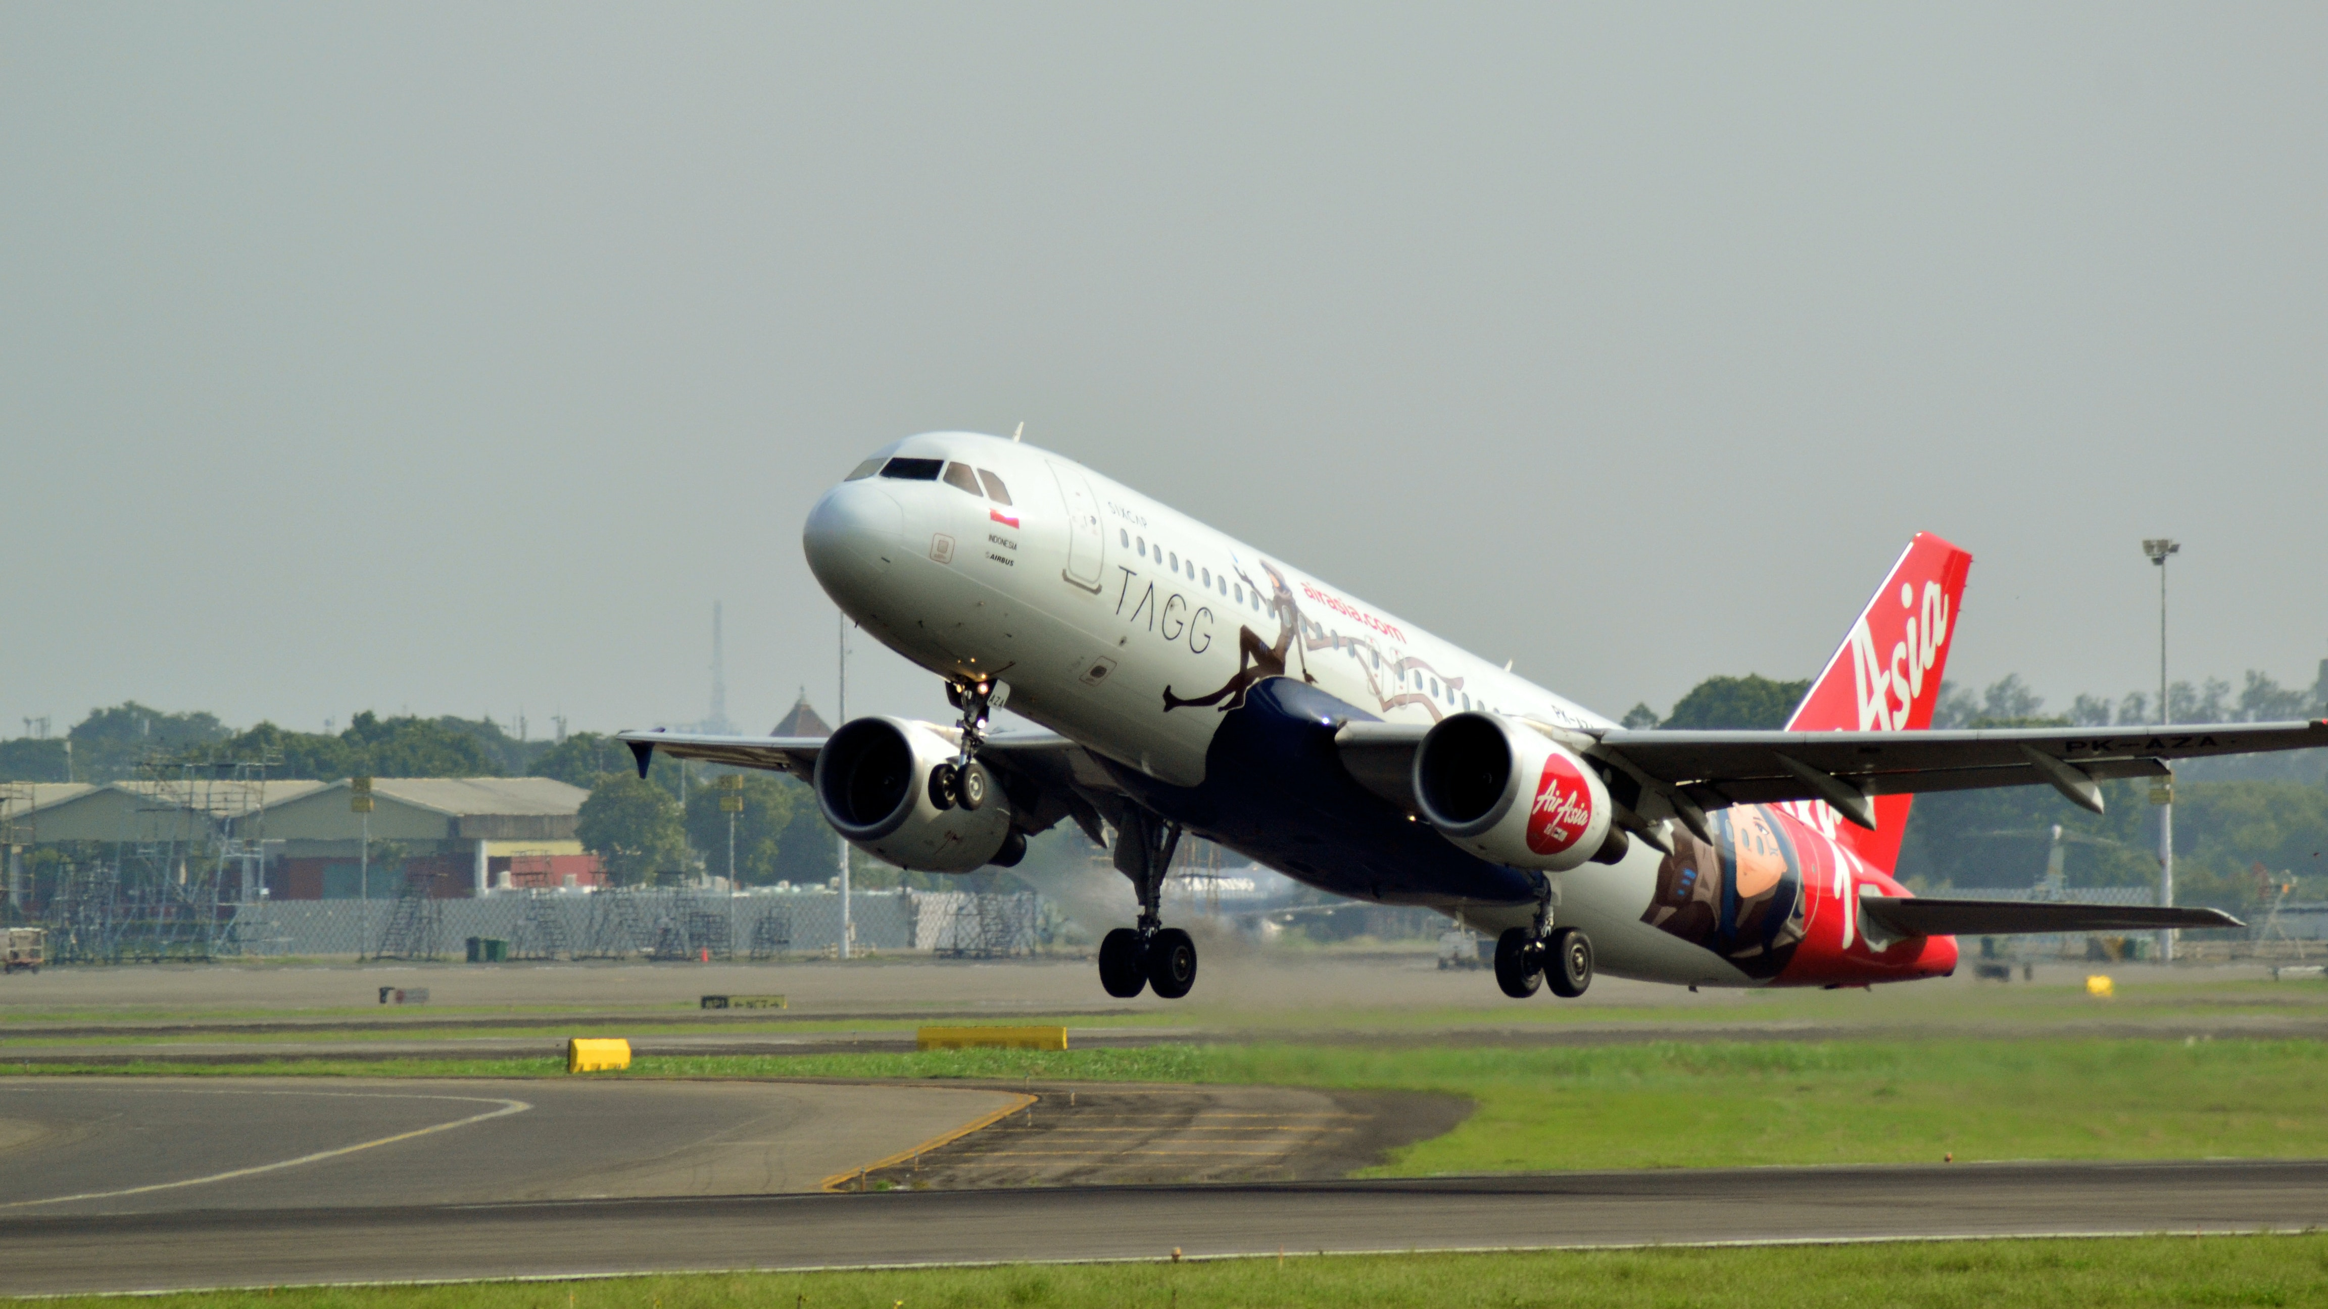
Airline Management system

Slide 2

Team members:
Presented by:
Vivek Salve,
Manish,
NaveenRaj,
G.Madhavan,
Sakeena banu,
Yasin malik.

Slide 3
Introduction:
Airline Reservation System aims to automate the flight operations and ticketing / seat booking and confirmation system of an Airline company. The software is providing options for viewing different flights available within a different timings for a specific day.
There is a database which is maintained in which all the names of Flights complete information is stored.
That provide customers within facility to able to book ticket smoothly. The customers can modify and able to cancel the ticket for any reason.
That prepare within a role and policies. The software should provide option for checking availability of the tickets. That is important for the customers to get message if the ticket unavailable. That will be displayed into customers. The customers should be noted when the change has been made or any further changes.

Slide 4
Purpose:
Easy to book a flight ticket.
Work becomes speedy.
Access of any information individually.
Decrease the load of the person involve in existing manual system.
Well-designed reports.
Easy & fast retrieval of information.
Accuracy in work.

Slide 5
Requirements:
Windows version 7+
Front end Software: Html , CSS , java script, Angular.
Backend software: Java, Spring Boot, Spring Data JPA, Database(Oracle).

Slide 6
Project scope:
Our project aims to safe and easy book and cancel a flight ticket i.e. we have made a computerized process to store data and distribution.
It satisfies the admin(Owner).
It is easy and safe to store data.
It is easy to operator.
Have a good user interface.
It saves time and function faster.
It helps the owner to manage the restaurant.
We have tried to develop safe and secure software with above mentioned specifications.

Slide 7


Used Tools and technologies:
Frontend: Html , CSS, Java script and Angular.
Back end: Spring tool suite
Database(Oracle).
VS Code
Online tools:
Eclipse
Word pad
Notepad

Slide 8
Modules:
Our system has four main modules as mentioned below: -
Register Module:
In this module the new users can create new account in our web-application.
Login Module:
In this module the user enter their login credentials and they will be redirected to their respective pages. The user will get only those privileges that are given to the user for which one has registered.

Slide 9
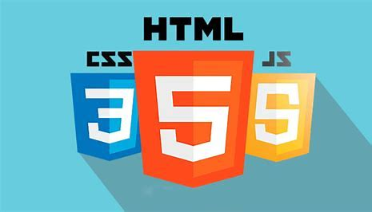
Frontend [language used]:
HTML
CSS
JAVA SCRIPT
Angular

Slide 10


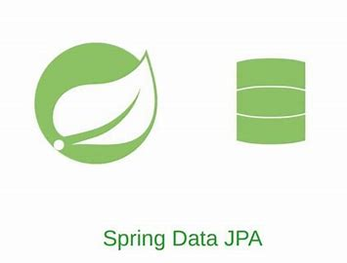
Backend [language used]:
JAVA
SPRING BOOT
SPRING DATA JPA

Slide 11

DATABASE:
Oracle SQL

Slide 12
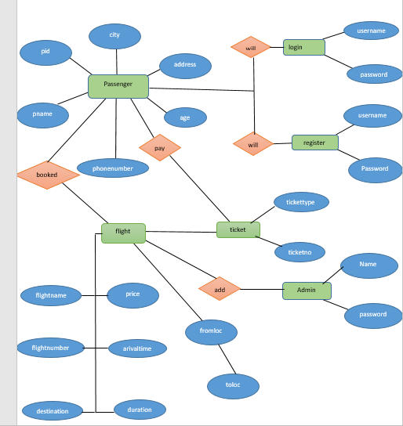
E-r diagram:

Slide 13
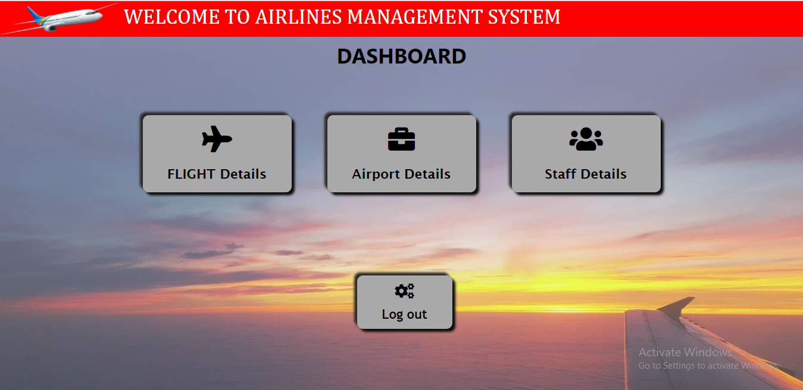
Home page:

Slide 14
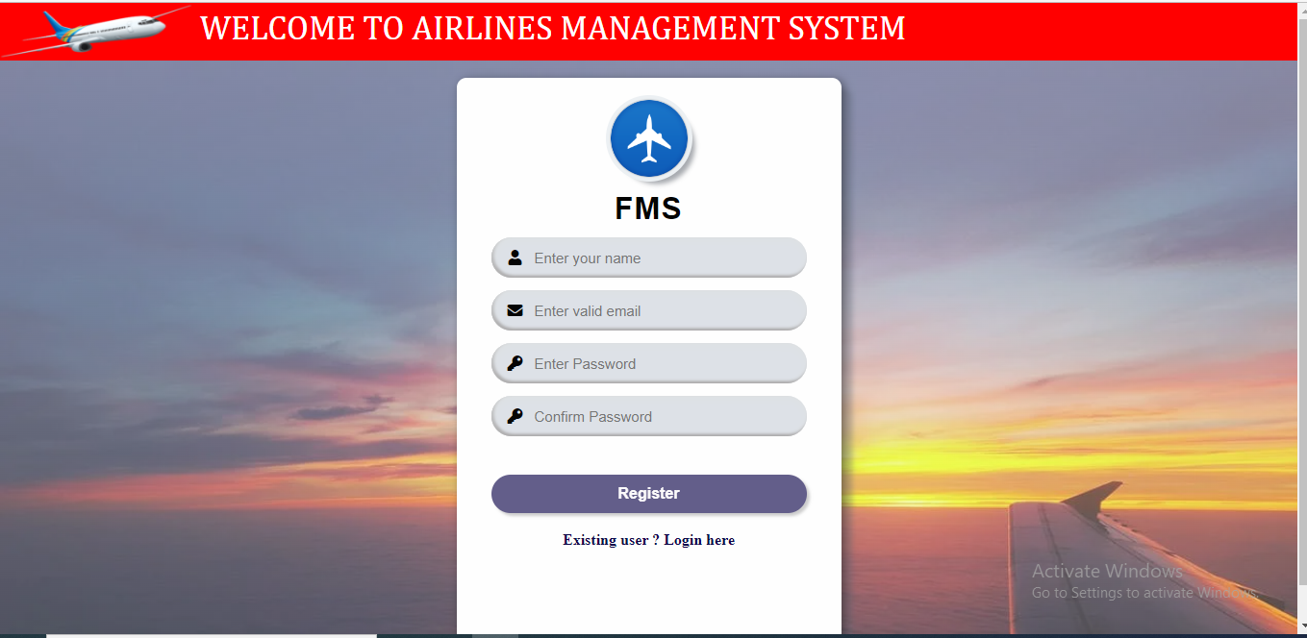
Register Page :-

Slide 15
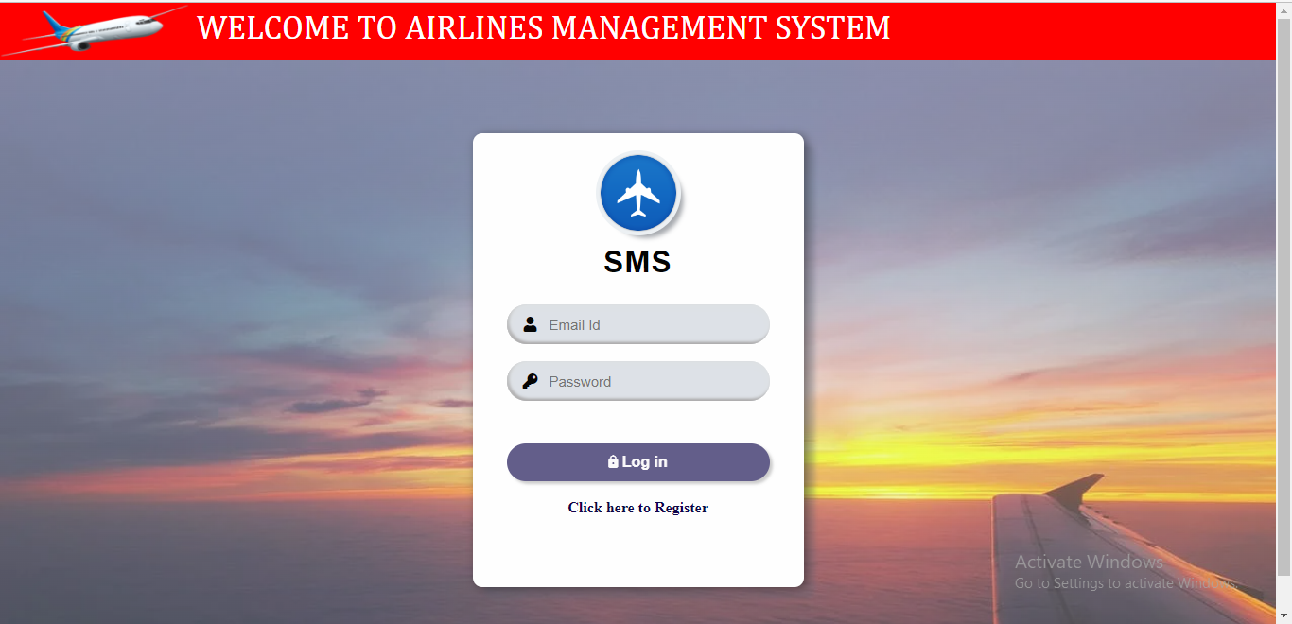
Login page :-

Slide 16
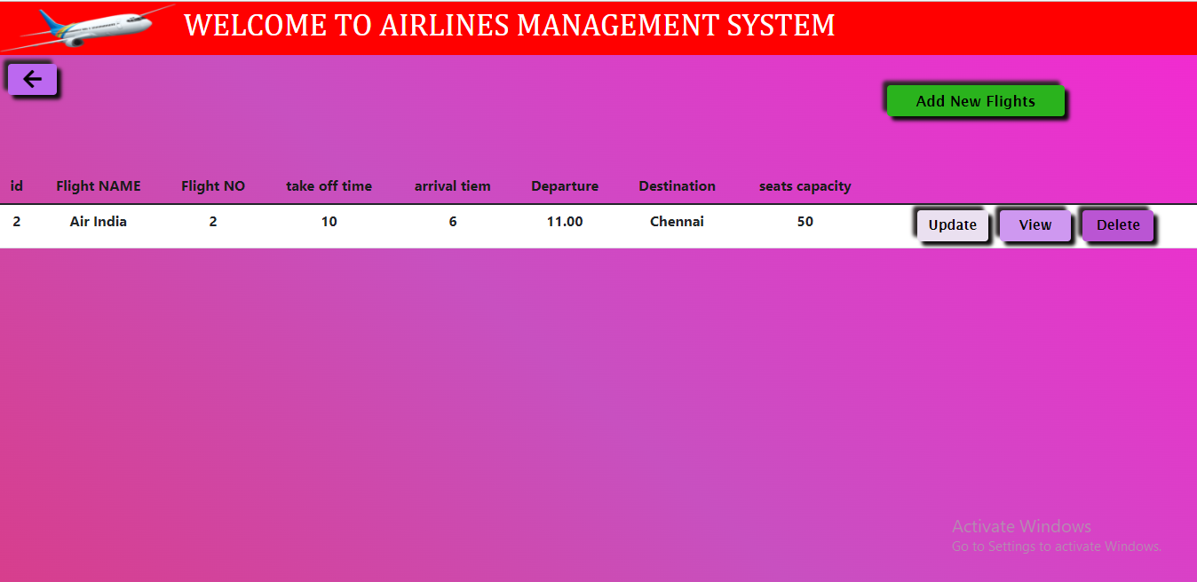
Details of Flights :-

Slide 17
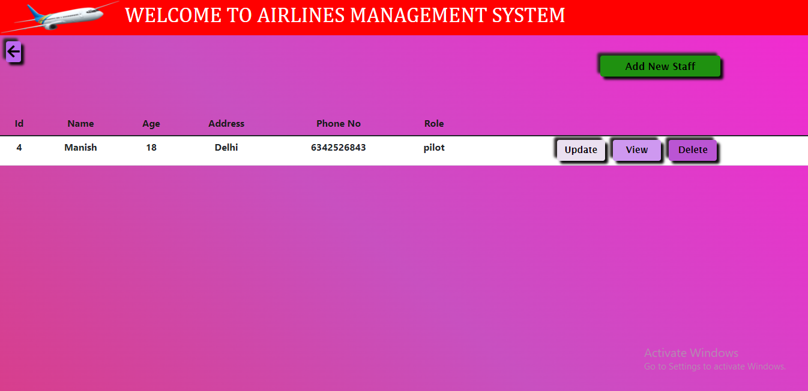
Details of Staff:

Slide 18
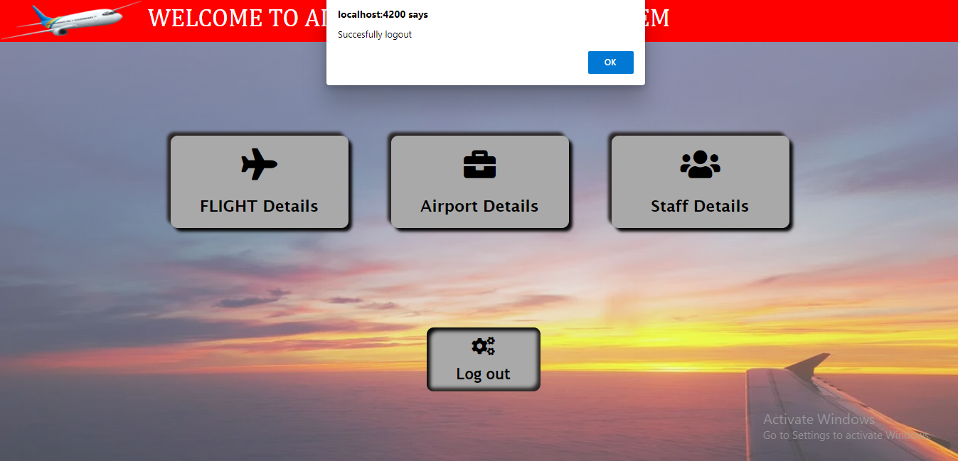
LOGOUT :

Slide 19
Thank you..

